Slide 1
Renewable energy

Slide 2
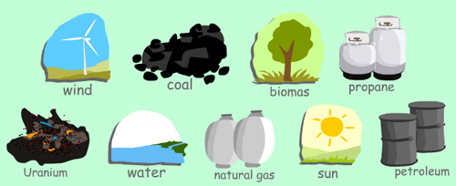
Energy exists freely in nature. Some of them exist infinitely (never run out, called RENEWABLE), the rest have finite amounts (they took millions of years to form, and will run out one day, called NON-RENEWABLE)

Slide 3
When can energy be called 'Renewable'?
When its' source cannot run out (like the sun) or can easily be replaced (like wood, as we can plant trees to use for energy)
When their sources are carbon neutral. This means they do not produce Carbon compounds (such as other greenhouse gases).
When they do not pollute the environment (air, land or water)

Slide 4
Types of rewenable energy
Wind power
Hydropower
Solar energy
Biomass
Biofuel
Geothermal energy

Slide 5
Solar power
Solar power is energy from the sun. "Solar" is the Latin word for "sun" and it's a powerful source of energy. Without it, there will be no life. Solar energy is considered as a serious source of energy for many years because of the vast amounts of energy that is made freely available, if harnessed by modern technology.
Solar cells are devices that convert light energy directly into electrical energy. In these cells, there are semiconductors (silicon alloys and other materials). You may have seen small solar cells on calculators or some mobile phones.
Solar panels do not generate electricity directly. Instead they heat up water directly. A pump pushes cold water from a storage tank through pipes in the solar panel. The water is heated by heat energy from the Sun and returns to the tank. They are often located on the roofs of buildings where they can receive the most sunlight.

Slide 6
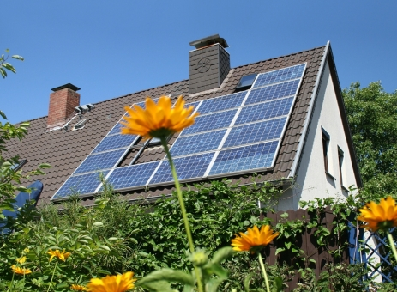
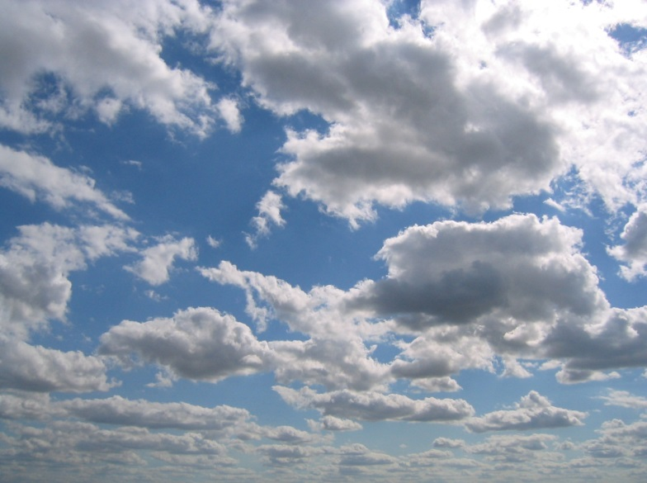
Solar power
Advantages
Disadvantages
No pollution
Free
Not available in the night and in rainy and cloudy days
It takes a lot of place

Slide 7
Biomass
This is a very common way of converting organic matter into energy. Burning stuff like wood, waste and other plant matter releases stored chemical energy in the form of heat, which can be used to turn shafts to produce electricity.

Slide 8
Biomass
Energy from the sun is transferred and stored in plants. When the plants are cut or die, wood chips, straw and other plant matter is delivered to the bunker
This is burned to heat water in a boiler to release heat energy (steam).
The energy/power from the steam is directed to turbines with pipes
The steam turns a number of blades in the turbine and generators, which are made of coils and magnets.
The charged magnetic fields produce electricity, which is sent to homes by cables.

Slide 9
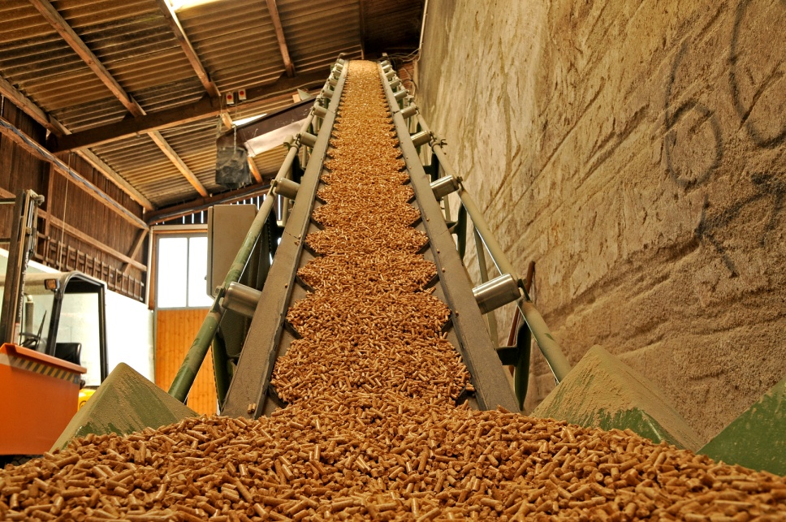
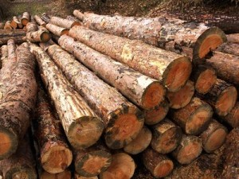
Biomass
Advantages
Disadvantages
Renewability
No waste
Almost every country can use it
High price
It takes a lot of place

Slide 10
Wind power
Wind is caused by huge convection currents in the Earth's atmosphere, driven by heat energy from the Sun. This means as long as the sun shines, there will be wind.
The moving air (wind) has huge amounts of kinetic energy, and this can be transferred into electrical energy using wind turbines. The wind turns the blades, which spin a shaft, which connects to a generator and makes electricity. The electricity is sent through transmission and distribution lines to a substation, then on to homes, business and schools

Slide 11
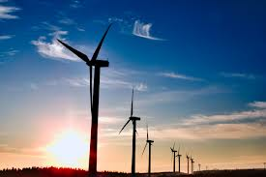
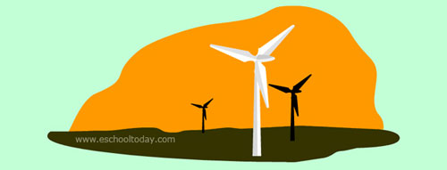
Wind power
Advantages
Disadvantages
One wind turbine can produce enough electricity to power up to 300 homes.
Low cost
Noise
Wind turbines cannot work if there is no wind, or if the wind speed is so high it would damage them

Slide 12
Water power
Moving water has kinetic energy. This can be transferred into useful energy in different ways. Hydroelectric power (HEP) schemes store water high up in dams. The water has gravitational potential energy which is released when it falls.

Slide 13
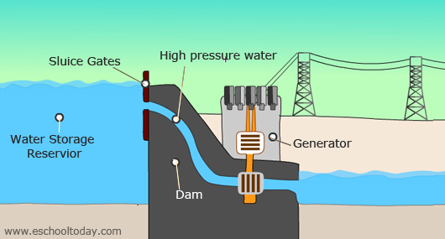
Water power
As the water rushes down through pipes, this stored energy is transferred to kinetic energy, which turns electricity generators.

Slide 14
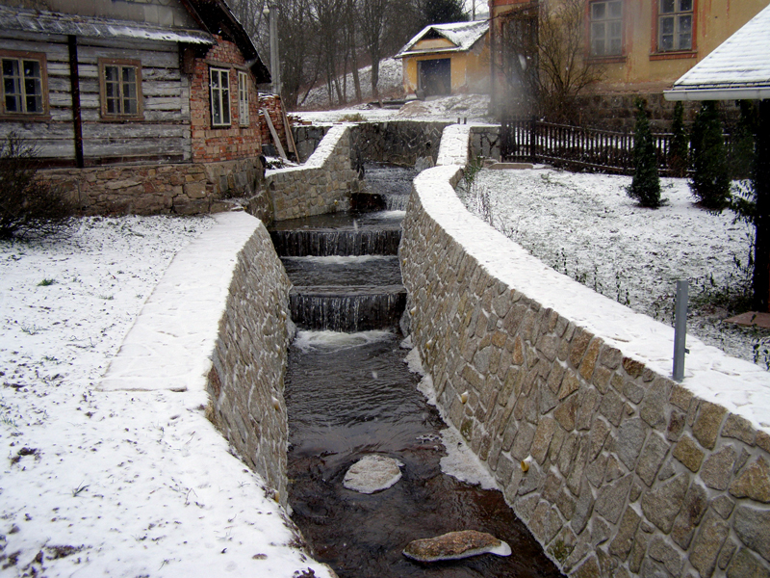
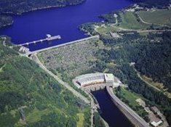
Water power
Advantages
Disadvantages
Inexhaustibility of water
Recreational purposes
Reservoir of drinking water
It prevents river transport
Chance of rupture

